Slide 1
Authoritarian Government
Communism, Theocracy, Monarchy, and Various other forms of Dictatorships
Notes:
We seem to love movies where the protagonist resists an authoritarian government. Some examples in the movies would include “V for Vendetta” and the “Hunger Games” series.

Slide 2
Lecture Outline
The Basics: Freedom v. Authoritarianism
Examples of Authoritarian Government
China (Communist) Russia (Dictatorial) Iran (Theocratic) Saudi Arabia (Monarchial)
Why Be Alarmed?

Slide 3
Freedom v. Authoritarianism The Basics
Freedom v. Authoritarianism: Freedom is controversial everywhere, even in America where we claim that we stand for “freedom,” but the bigger picture is ideological
For instance, what is the best way to organize a society, under a free government or under an authoritarian government?
The world is divided on this issue
Much of the conflict in the world is caused by this ideological conflict: freedom v. authoritarianism
There are a variety of types of authoritarian governments in the world:
China – officially a communist government but economic freedom is being allowed in the business world
Russia – officially a democracy, but in reality power is concentrated in the president (Vladimir Putin)
Iran – officially a theocracy (religious government), though Iran has a thriving democratic element, the religious side of government can veto anything passed by civilian (democratic) side of government
Saudi Arabia – officially a monarchy though there is a sharing of power between the religious side of government and the royal family

Slide 4

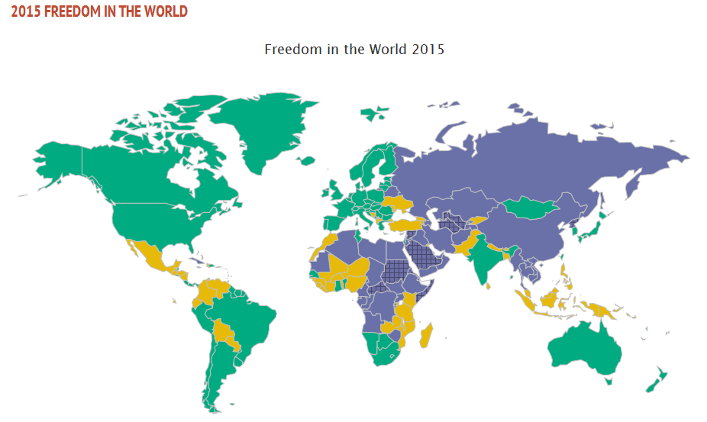
Authoritarian Government An International Perspective
Each authoritarian government profiled in this lecture—China, Russia, Iran, and Saudi Arabia—are categorized by Freedom House as “not free”
Notes:
Source: http://www.freedomhouse.org
The rating scale ranges from 1 to 7
Rating of “1” implies that civil liberties are protected most
Rating of “7” implies that there are no civil liberty protections
Freedom House defines civil liberties by the following criteria:
Civilian control of the police,
Protection from police terror,
Unjustified imprisonment, exile, torture,
Absence of civil war and insurgency,
Absence of economic exploitation (i.e., sweatshops),
Corruption of government, military, or organized crime in business
Right to own private property and businesses
The criteria Freedom House uses to judge countries are easily met in many westernized countries. For instance, there is civilian control of the police in America, but in many countries around the world, the military does local policing actions. It’s usually bad news when the military gets involved in local policing; it can lead to military takeovers (coups) of government. Also, there is no civil war or insurgency in America. Those occurred earlier in our history but are unlikely to reoccur.

Slide 5
Authoritarian Regimes
China, Russia, Iran, and Saudi Arabia

Slide 6
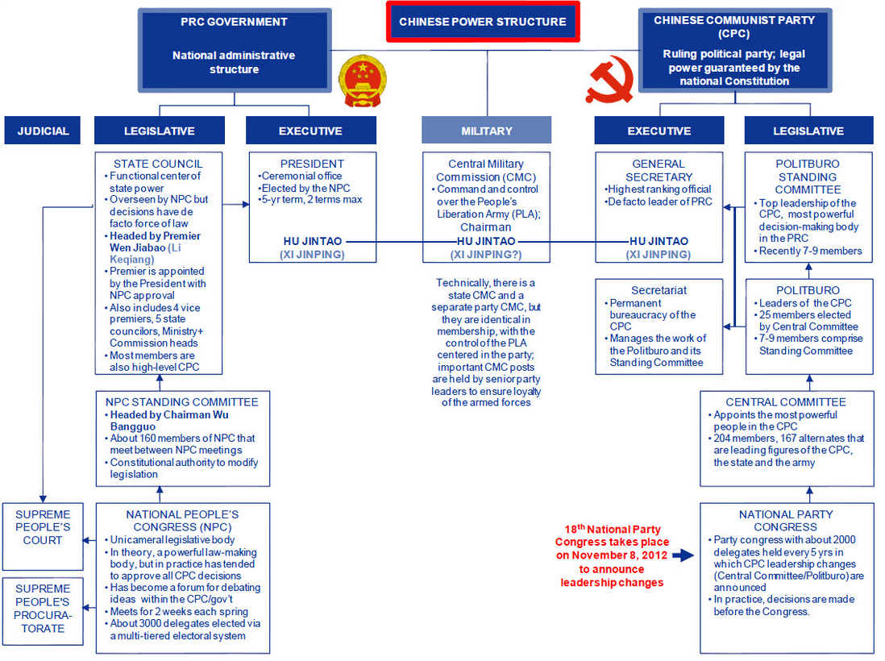
China Organization of Government
China has what appears to be separation of powers (executive, legislative, judicial) but the real power in the country resides in the communist party
The 9-member standing committee of the communist “politburo” holds the real power
Notes:
The leader shown on this graphic, Hu Jintao, is no longer the leader. China changes its leadership every 10 years (officially every 5 years, but typically leaders serve two 5-year terms).
https://www.msn.com/en-us/sports/winter-olympics/nathan-chen-eileen-gu-and-zhu-yi-china-s-starkly-different-reactions-to-us-born-olympians/ar-AATKBLs?ocid=msedgdhp&pc=U531 – How three (3) winter Olympians of Chinese decent have been treated in the Chinese media. China is an authoritarian country, and its media is controlled by the government.

Slide 7
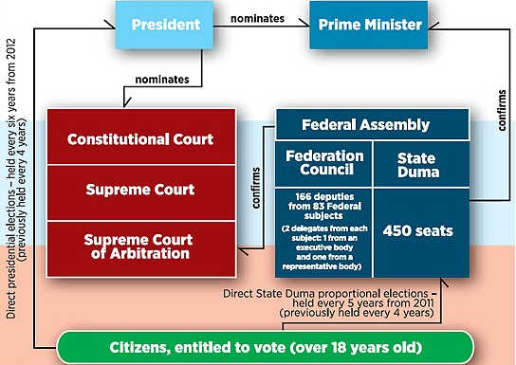
Russia Organization of Government
The Russian government is officially a “democracy,” but the president (Vladimir Putin) has consolidated most power in the chief executive (the president)
Putin has ruled Russia, either as president or prime minister, since 2000 and he expects to be “elected” once more, holding power until at least 2024

Slide 8
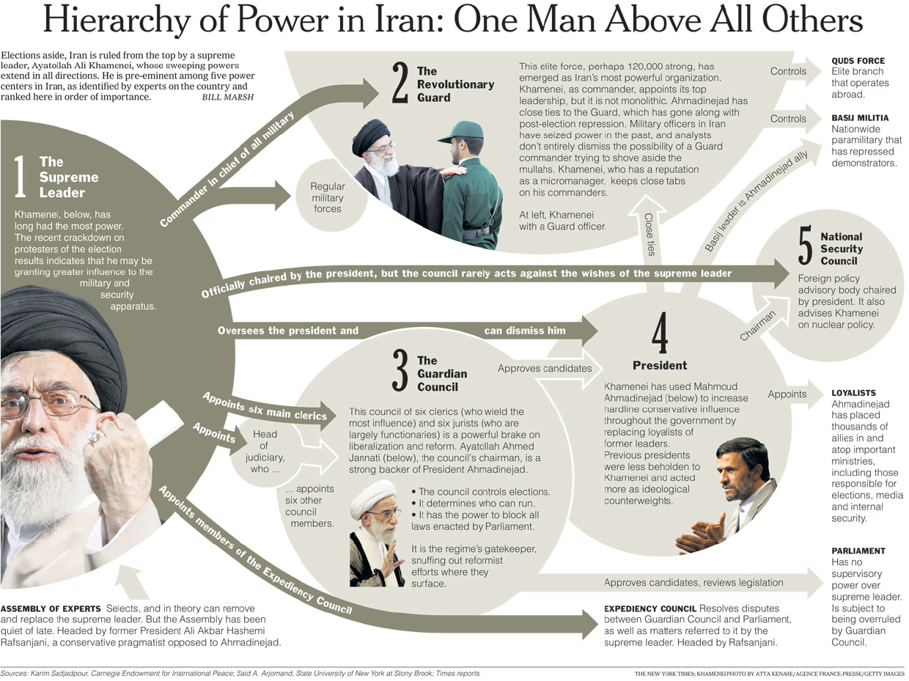
Iran Organization of Government
The Supreme Religious Leader controls most of the important institutional bodies in the Iranian governing hierarchy
Notes:
Some of the faces on the graphic have changed. For instance, Mahmoud Ahmadinejad is no longer president of Iran; he was term-limited out after serving two 4-year terms as president. The new president is Hassan Rouhani, elected in June 2013. The Supreme Religious Leader, Khamenei, is still the leader of the country.

Slide 9
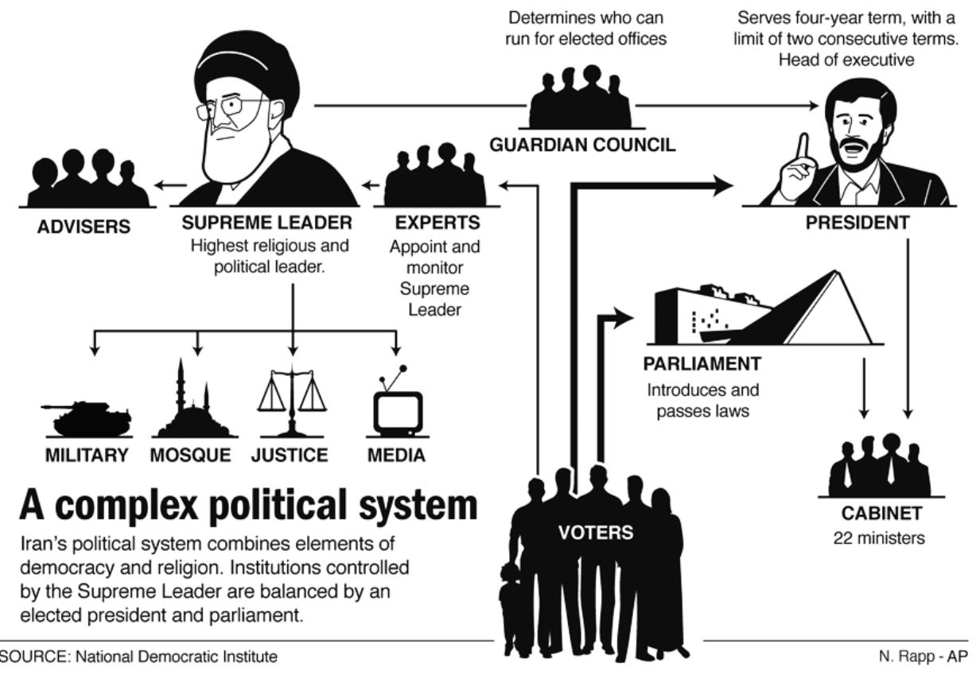
Iran Organization of Government
Despite that there is a thriving democratic element in Iran,
the Supreme Religious Leader has control over the military, the religious hierarchy, the justice system, and the media

Slide 10
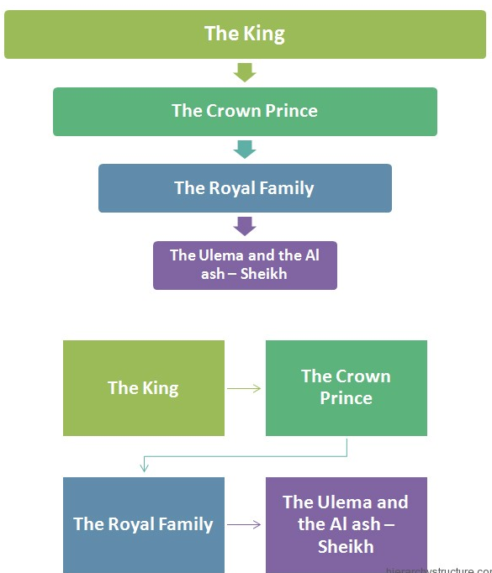
Saudi Arabia Organization of Government
Though Saudi Arabia is an official Monarchy, there is a power-sharing arrangement between the royal family and the Ulema (the religious clerics)
The Ulema enforces religious law in the country, and adjudicates family and property disputes
While the royal family oversees economic and foreign policy areas
Notes:
This power-sharing arrangement has historical roots, first established in 1744, Abdul Wahhab and Muhammad bin Saud formed an alliance to unify the Arabian Peninsula (which was not controlled by the Ottoman Empire). Abdul Wahhab, who represented the religious arm of the alliance (al-Sheikh family), agreed to sanction a Jihad against “bad” Muslims if the al-Saud family adhered to Wahhab’s interpretation of Islam (Sharia law enforced by religious police). This arrangement has persisted ever since, with the balance of power shifting more to the Saudis in times of stability and more to the Sheikhs in times of crisis. The Saudis turn to the Grand Ulema Authority (Wahhabi or Salafist clerics) for authority during times of crisis. In 1979, when the Great Mosque in Mecca was seized in protest of modernization/westernization of the Kingdom, the Ulema authorized the regime (issued a Fatwa) to kill the perpetrators. In 1990, when Saddam Hussein invaded Kuwait and was poised to invade the Kingdom, the Ulema granted another fatwa to allow US troops to be stationed on Saudi soil. This fatwa caused intense dissention among religious leaders in Saudi Arabia.

Slide 11
Authoritarianism
The Corruption of the International Olympic Committee (IOC)

Slide 12
Influence of Authoritarian Regimes The Corruption of the International Olympic Committee
The International Olympic Committee (IOC) is heavily criticized for catering to authoritarian regimes, namely, China and Russia, because these countries buy-off IOC officials and host lavish Olympics
Kamila Valieva was allowed to compete at the Beijing Winter Olympics (2022) while she was under investigation for a doping scandal (a banned substance that improves oxygen flow to the heart under extreme physical stress)
The Russians have a history of doping and are not allowed to compete in the Olympics under their country’s flag. Instead, they compete under the Russian Olympic Committee (ROC) flag
Notes:
https://www.cnn.com/2022/02/14/sport/shacarri-richardson-questions-participation-kamila-valieva-olympics/ -- Russia’s influence with the IOC may be the reason that Kamila was allowed to compete. Sha’Carri Richardson believes that she was not allowed to compete in the Summer 2021 games because she is black. The IOC responded, see this video: https://www.bing.com/videos/search?q=IOC+Says+Sha%27carri+Richardson+and+Kamila+Valieva%27s+Doping+Controversies+Are+%27Very+Different%27&docid=13846684305248&mid=52E602D8AEA40725209152E602D8AEA407252091&view=detail&FORM=VIRE
The Kamila Valieva ordeal proved a need for Olympic reform. Here are three places to start. (msn.com)
https://www.msn.com/en-us/sports/winter-olympics/the-kamila-valieva-ordeal-proved-a-need-for-olympic-reform-here-are-three-places-to-start/ar-AAU3buF?cvid=585c2f9442e24cbfa62f1a9dbce3095e&ocid=winp1taskbar
https://www.msn.com/en-us/news/world/don-t-let-evil-adults-cripple-you-russians-continue-to-defend-kamila-valieva-fire-back-at-ioc-president/ar-AAU1JdY?ocid=msedgntp – Russian news agencies rally behind Kamila Valieva

Slide 13
Authoritarianism
The Reach of Authoritarian States

Slide 14
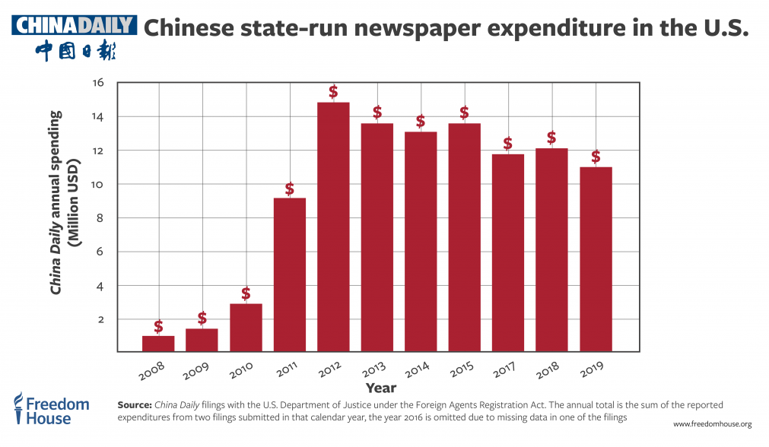
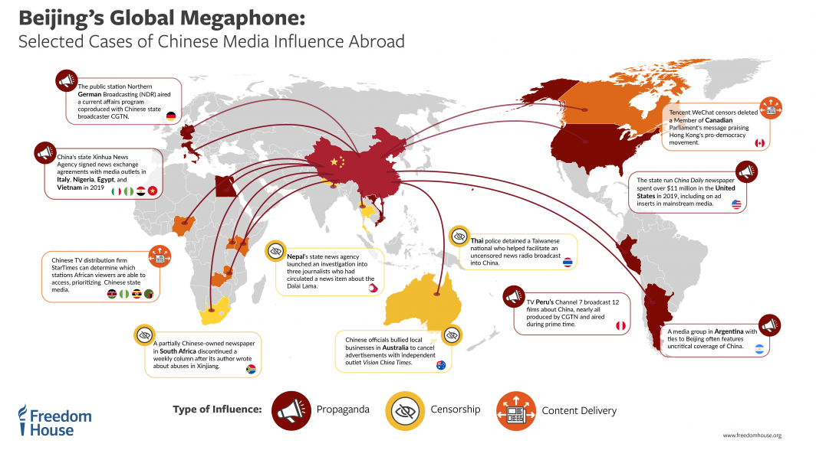
Influence of Authoritarian Regimes China’s International Media Influence
China understands that image matters in international affairs, and it is investing heavily in influencing foreign media sources on how they portray China
Notes:
Source: Beijing's Global Megaphone | Freedom House https://freedomhouse.org/report/special-report/2020/beijings-global-megaphone

Slide 15
Conclusions
The pressure (norm) in the world is to move toward democracy
For instance, 63% of the world’s countries are electoral democracies
But authoritarian regimes constitute about 25% of the world today, and authoritarianism has increased over the last decade
Why be alarmed about authoritarianism?
Ideological differences (e.g., democracies v. dictatorships) often lead to conflict
For instance, at the heart of the ideological conflict in the war on terror is freedom v. authoritarianism (democracy v. theocracy)
Liberal democracies disagree on a great many issues, but they don’t go to war with one another
For instance, the thought of Germany and France going to war today is so absurd that no rational person would ever think such a thought, reason being that both countries are “real” democracies today
Notes:
See: https://freedomhouse.org/report/freedom-world-2014/essay-democratic-leadership-gap#.VHwWNGe9aPr
Excerpts from Freedom House: 2014 Report on Freedom in the World (a look back at 2013)
For the eighth consecutive year, Freedom in the World, the report on the condition of global political rights and civil liberties issued annually by Freedom House, showed a decline in freedom around the world. While the overall level of regression was not severe—54 countries registered declines, as opposed to 40 where gains took place—the countries experiencing setbacks included a worrying number of strategically or economically significant states whose political trajectories influence developments well beyond their borders: Egypt, Turkey, Russia, Ukraine, Azerbaijan, Kazakhstan, Indonesia, Thailand, Venezuela. The year was also notable for the growing list of countries beset by murderous civil wars or relentless terrorist campaigns: Central African Republic, South Sudan, Afghanistan, Somalia, Iraq, Yemen, Syria.
Modern Authoritarianism in Action
While freedom suffered from coups and civil wars during the year, an equally significant phenomenon was the reliance on more subtle, but ultimately more effective, techniques by those who practice what is known as modern authoritarianism. Such leaders devote full-time attention to the challenge of crippling the opposition without annihilating it, and flouting the rule of law while maintaining a plausible veneer of order, legitimacy, and prosperity. Central to the modern authoritarian strategy is the capture of institutions that undergird political pluralism. The goal is to dominate not only the executive and legislative branches, but also the media, the judiciary, civil society, the economy, and the security forces. While authoritarians still consider it imperative to ensure favorable electoral outcomes through a certain amount of fraud, gerrymandering, handpicking of election commissions, and other such rigging techniques, they give equal or even more importance to control of the information landscape, the marginalization of civil society critics, and effective command of the judiciary. Hence the seemingly contradictory trends in Freedom in the World scores over the past five years: Globally, political rights scores have actually improved slightly, while civil liberties scores have notably declined, with the most serious regression in the categories of freedom of expression and belief, rule of law, and associational rights. A result of this approach is that elections are more likely to be peaceful and at least superficially competitive, even as authoritarian (or aspiring authoritarian) incumbents use multiple tools to manipulate the electoral environment as needed. In Zimbabwe, for example, the elections of 2013 were less objectionable than in past years, if only due to the absence of widespread violence perpetrated by security forces loyal to President Robert Mugabe. Although observers judged that procedures on election day were relatively fair, the outcome was strongly influenced by policies and abuses meant to tilt the playing field months before the balloting took place.

